Slide 1
Online Quantum Computing Activities

Slide 2
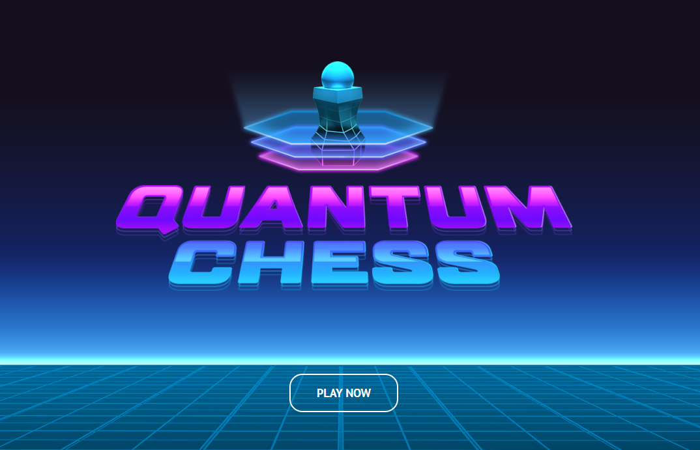
Quantum Chess

Slide 3
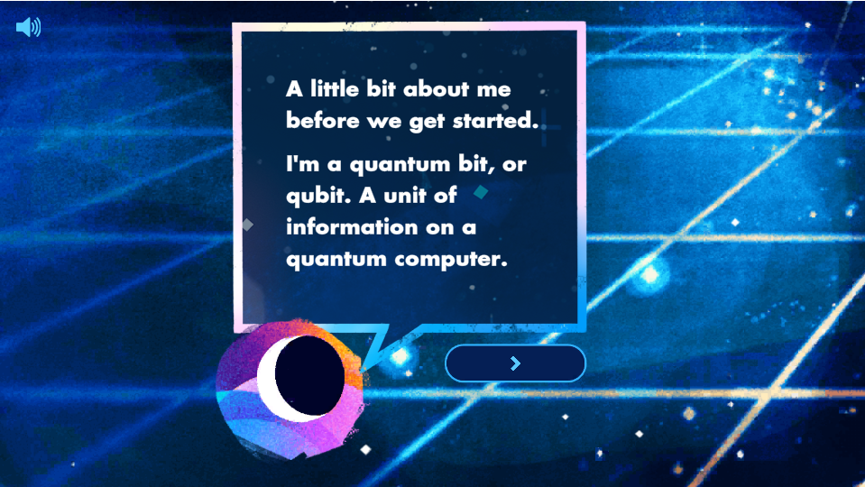
Quantum Chess
The Quantum Chess activity is designed to walk you through basics of Quantum Computing and Quantum Mechanics

Slide 4
Quantum Chess
Quantum Chess was created by the California Institute of Technology in conjunction with Google Quantum AI, Quantum Realm Games, Western Illinois University, and ArcanForge
Through playing chess, the fundamentals of Superposition, Measurement, and Entanglement can be taught in a fun and exciting way

Slide 5
Quantum Chess
Navigate to the Quantum Chess website:
https://iqim.caltech.edu/quantum-puzzles/#game

Slide 6
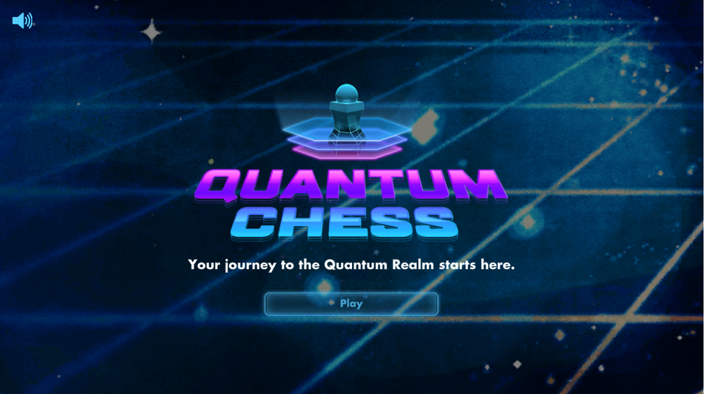
Quantum Chess
Scroll to the bottom of the screen and then click on “Play”

Slide 7
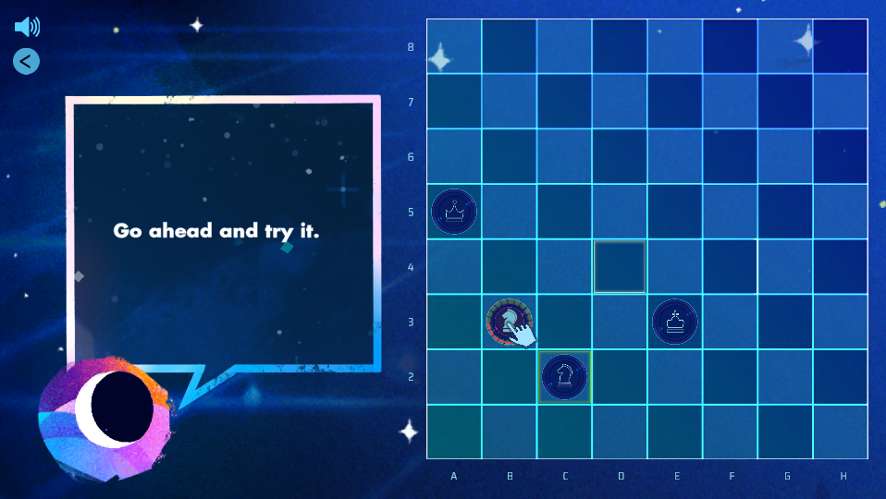
Quantum Chess
Play through the game until you are through all of the puzzles

Slide 8
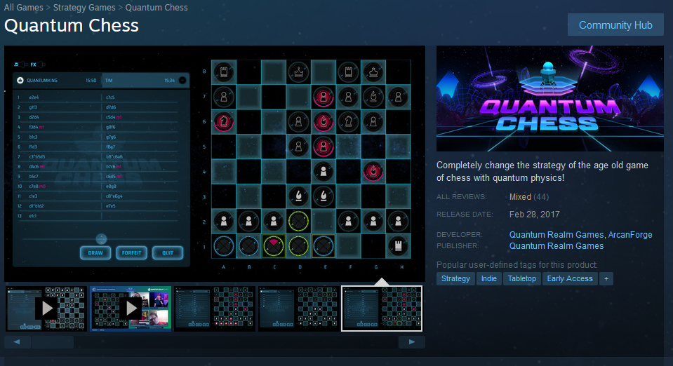
Quantum Chess
This version of the game is more of a tutorial to explain quantum concepts and how they would work on a chess board
If you are interested, a full Quantum Chess Game is available on Steam, a video game launcher
https://store.steampowered.com/app/453870/Quantum_Chess/#app_reviews_hash

Slide 9
Quantum Chess
Key Terms:
Superposition: The ability of a quantum system to be in a multiple states at the same time
Measurement: Testing a quantum system in superposition to get a measurable result
Entanglement: A pair or group of quantum particles that are linked together in superposition. Measuring one particle will determine the results of the other particle(s)

Slide 10
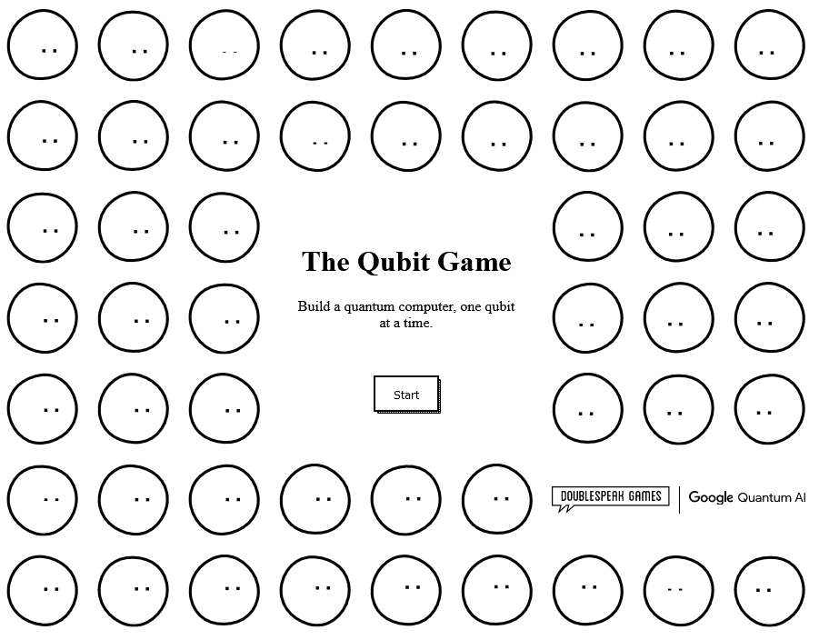
The Qubit Game

Slide 11
The Qubit Game
The Qubit Game is a idle or clicker game, similar to Adventure Capitalist or Cookie Clicker, but with a different object
The idea behind the game is to build a quantum computer by adding more qubits to your computer
You’ll slowly build up the size of your quantum computer and be able to purchase upgrades along the way
You’ll have to fight off the heat that builds up in the computer, which is a real problem in real Quantum Computers
The game teaches you how Quantum Computers work in a very fun way

Slide 12
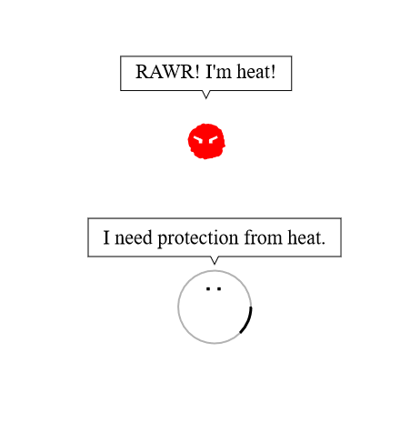
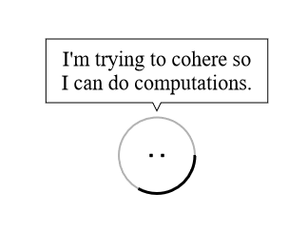
The Qubit Game

Slide 13
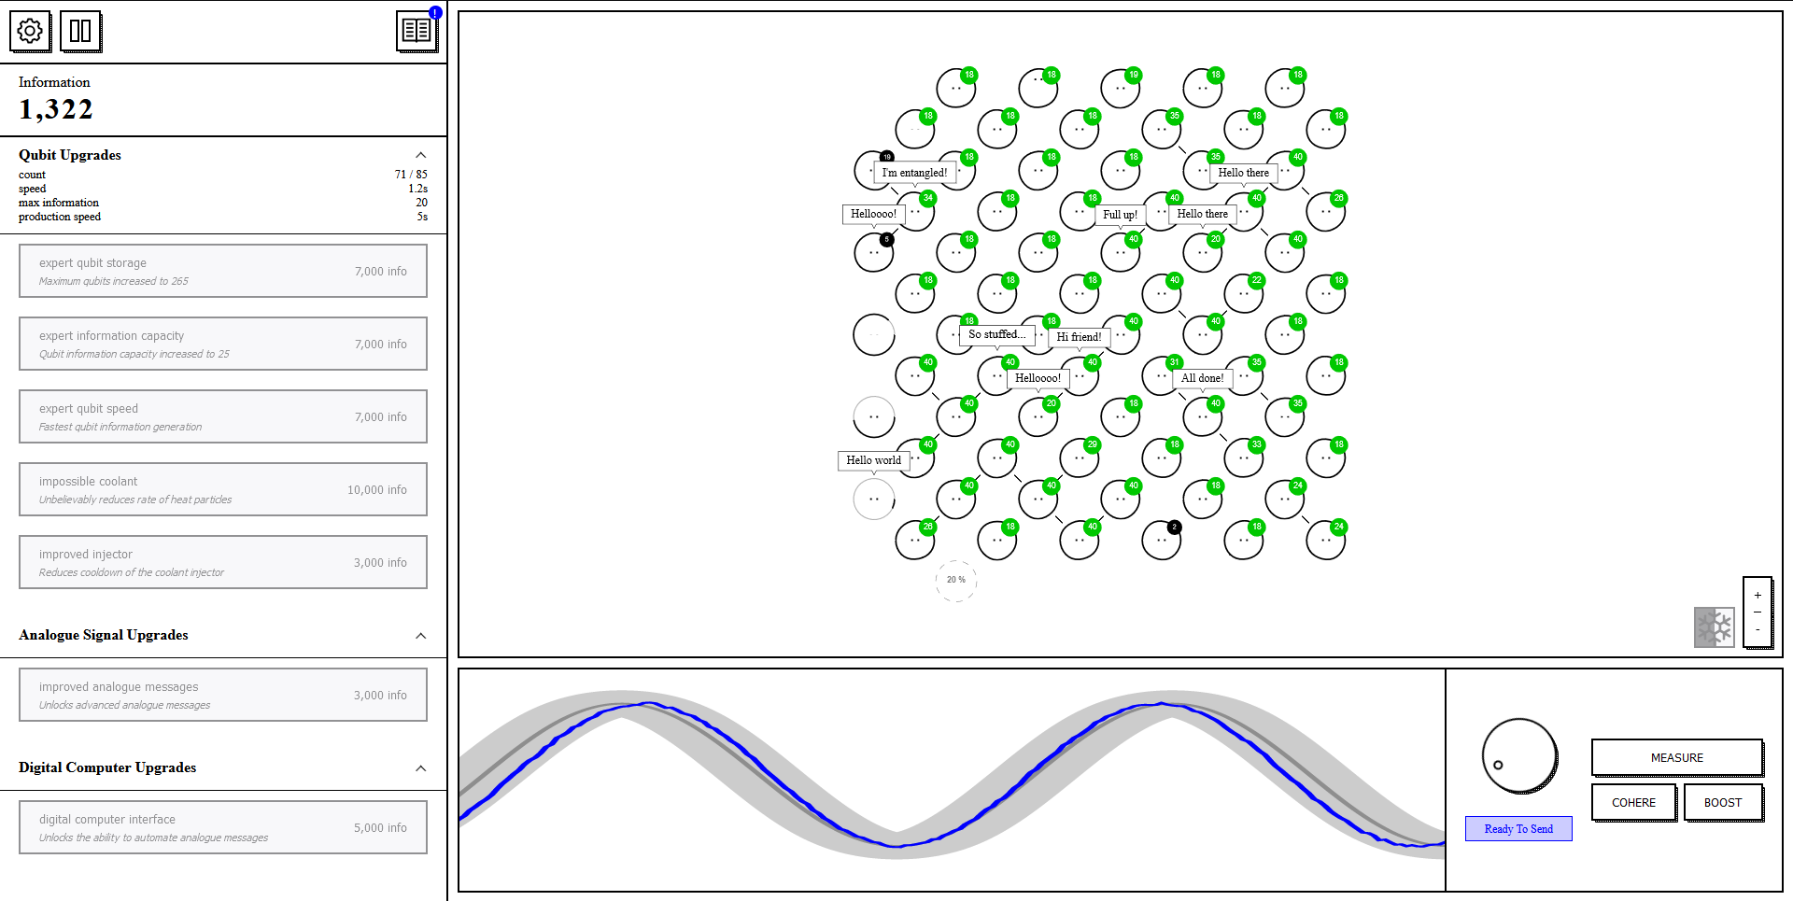
The Qubit Game

Slide 14
The Qubit Game
The game was developed by Google Quantum AI Lab and can be found at the link here
https://quantumai.google/education/thequbitgame
Play through the game and build your Quantum Computer

Slide 15
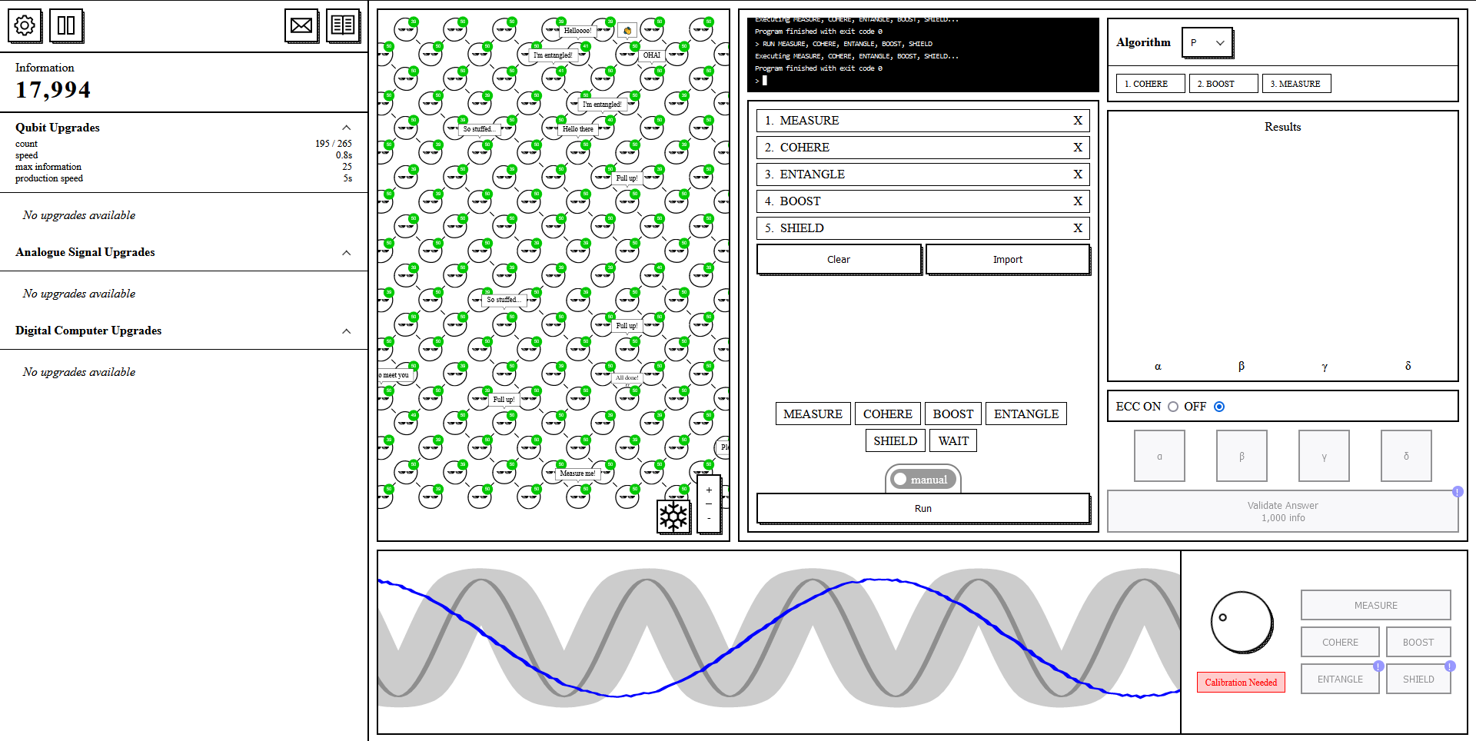
The Qubit Game

Slide 16
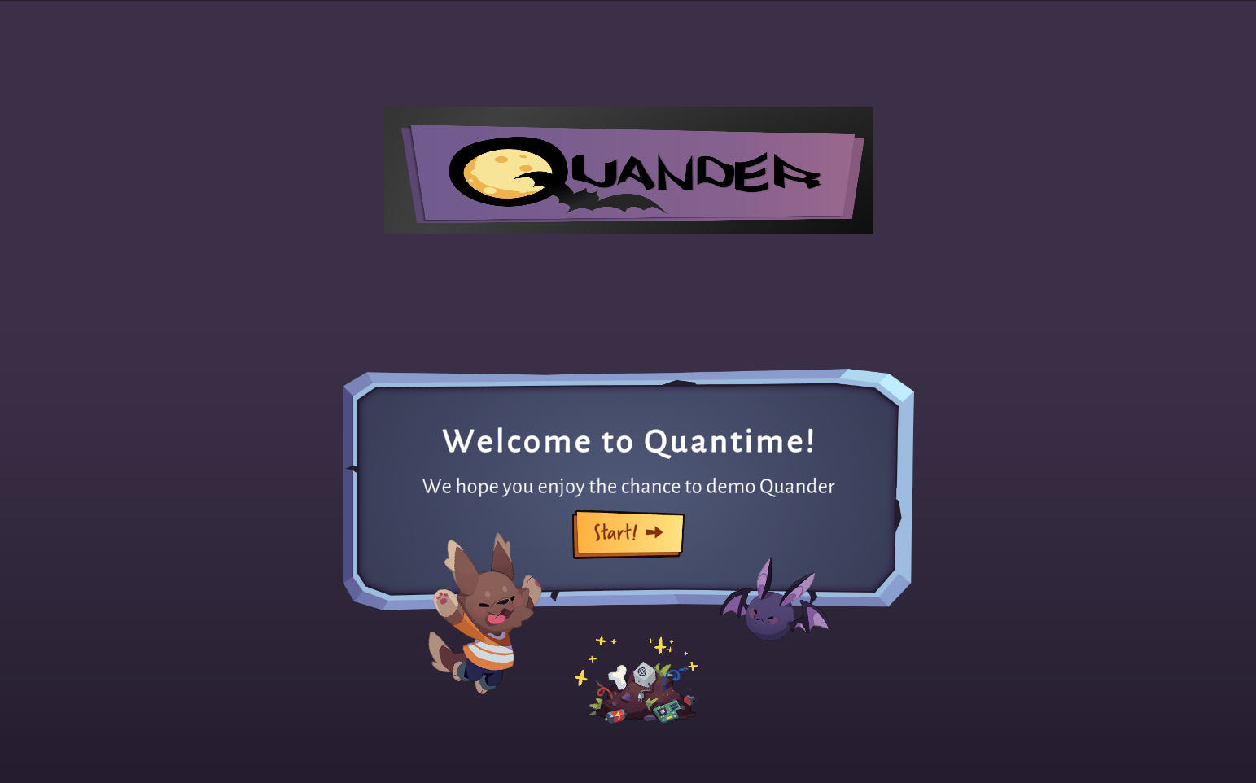
Quander

Slide 17
Quander
Quander is a story game developed by Amazon that is designed to take you through a story and teach you Quantum Computing basics
Similar to the games from earlier, the Quantum Computing and Quantum Mechanics concepts are taught in fun, interesting, and easy to understand ways

Slide 18
Quander
Navigate to the website in the link:
http://quander-lite.s3-website-us-east-1.amazonaws.com/
Once the game loads, click “Start” and play through the game

Slide 19
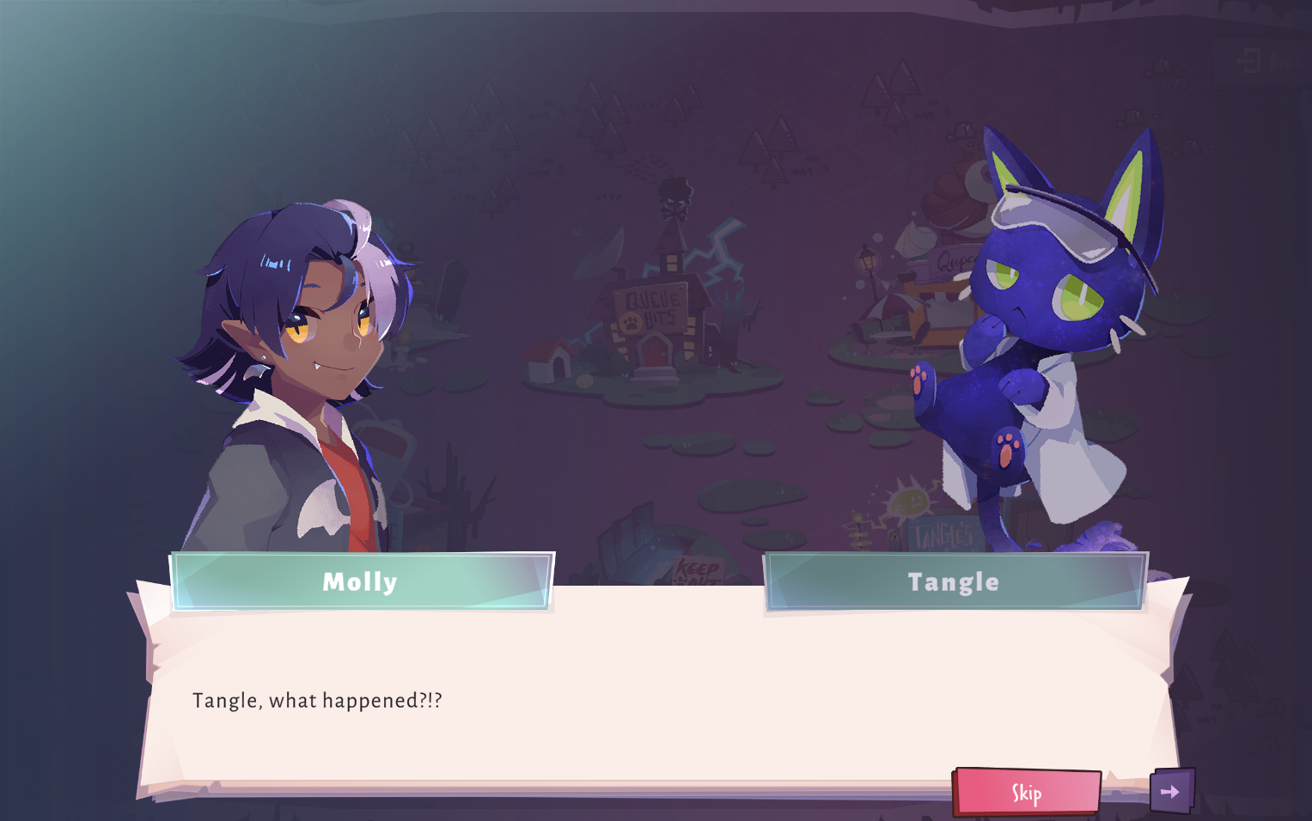
Quander

Slide 20
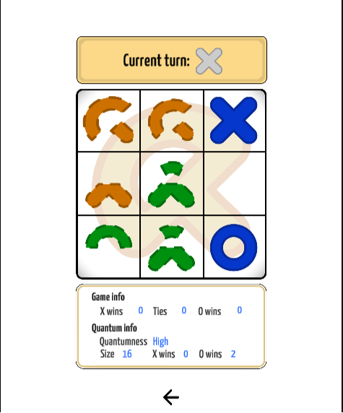
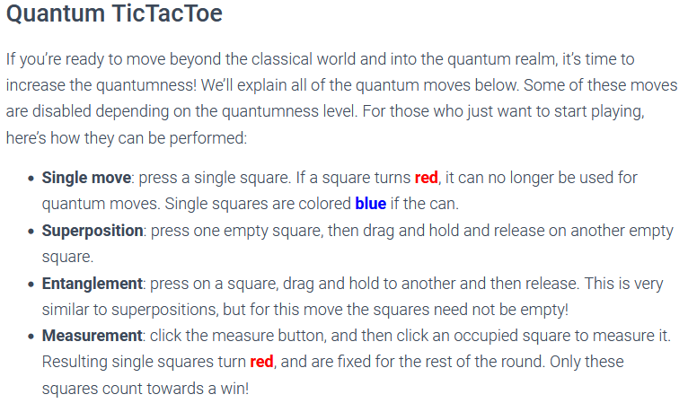
More Links
Quantum Tic-Tac-Toe:
Tic-Tac-Toe with a Quantum twist
https://quantumtictactoe.com/play/

